Slide 1
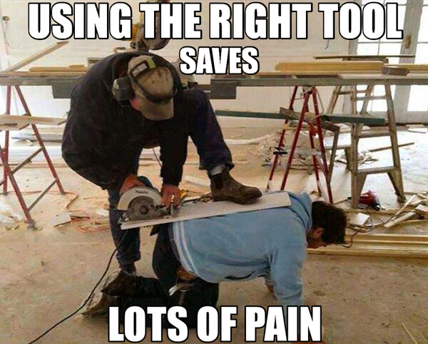
Epub Creation Tools Comparison
A Guide for the rest of us.
By Amy Mason, Access Technology Specialist, National Federation of the Blind

Slide 2
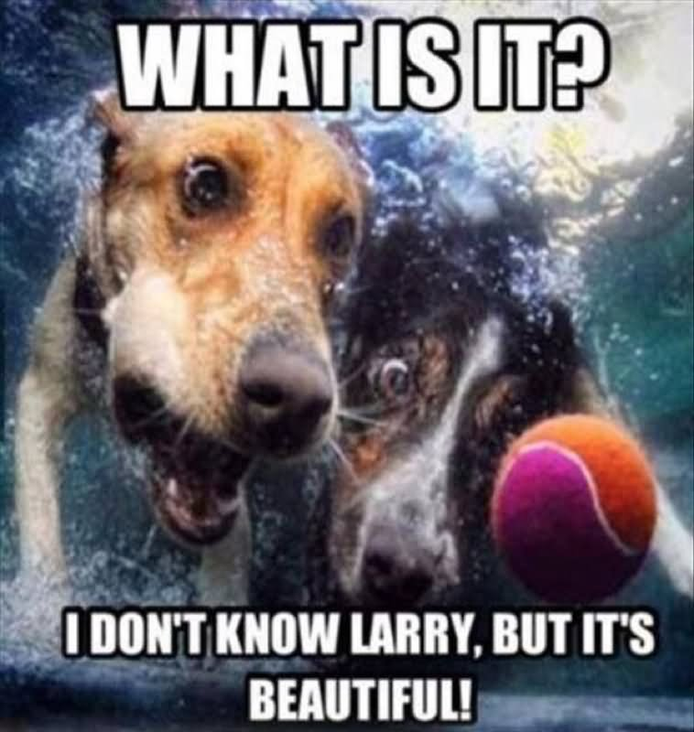
What is Epub Anyway? "If I had asked people what they wanted, they would have said faster horses." Henry Ford
EPUB is a digital publishing format intended for providing access to books, periodicals, and other long form documents.
Open Standard.
Most recent versions of the format allow for robust accessibility support
EPUB 3.x

Slide 3
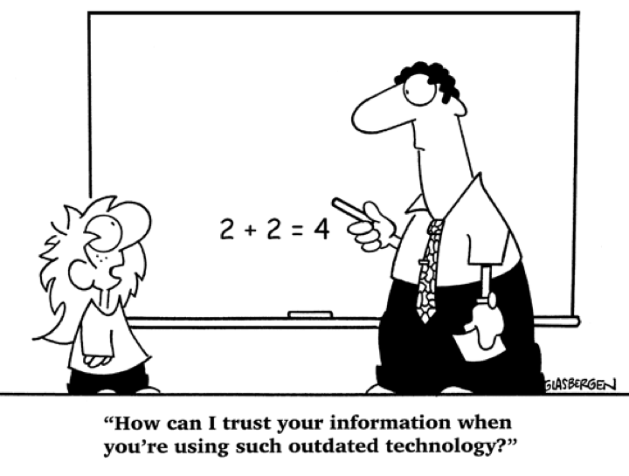
Isn’t PDF Good Enough?
Try reading a long PDF on a smartphone
Tagging is important for accessibility
There is a high learning curve for creating well-tagged PDF
Not a native part of the format, added on later, so odd things can happen
Tags are not fully supported on Mobile.

Slide 4
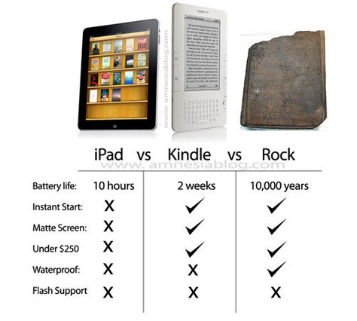
What about Kindle?
Proprietary format
It’s fortunes rise and fall with the success of Amazon
Your users may want to access your documents on Kindle, but…
You probably don’t want to be limited to that one platform.

Slide 5
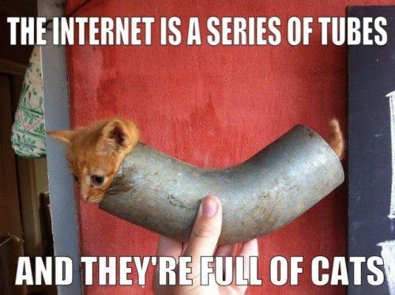
Epub Benefits
Built out of common web technologies
Highly accessible structure
Allows for reflow
Can be interactive, including video, and possible narration
Supported widely by e-readers and reading platforms
Even Amazon prefers EPUB 3 for ingestion
(It’d be brilliant if any of them would publicly admit to it though)

Slide 6

Common Ebook Readers that support EPUB (usually under a different name)
Google Play Books
iBooks
Kobo
Nook
VitalSource
RedShelf

Slide 7

Problems with Epub
No one seems to know how to create it. There are many professional ePub files (of varying quality) but end user content creators don’t have many well-known options for creating accessible ePub.
Few end users know that they are actually using ePUBS in most commercial eReading platforms
Or that in the case of Kindle, their book was probably created in that format to begin with.

Slide 8
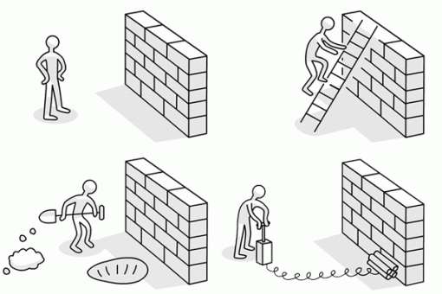
Overcoming the challenges
Neither of the challenges above actually constitute a problem for designers or readers once they have been offered an education
So… allow me to offer you at least an introductory education….

Slide 9
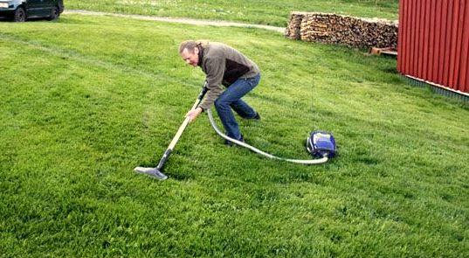
Choosing the best tool for you
What features do you need?
What do you have on hand?
How much knowledge does the tool require to use it?
How is the output?

Slide 10
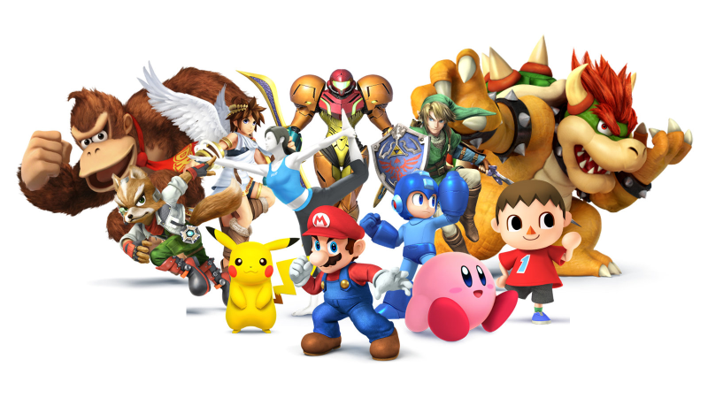
The Contenders
Adobe InDesign
VitalSource Content Studio
iBooks Author
Pages
Google Docs
Calibre
Codex
Sigil
Equidox by Onix

Slide 11
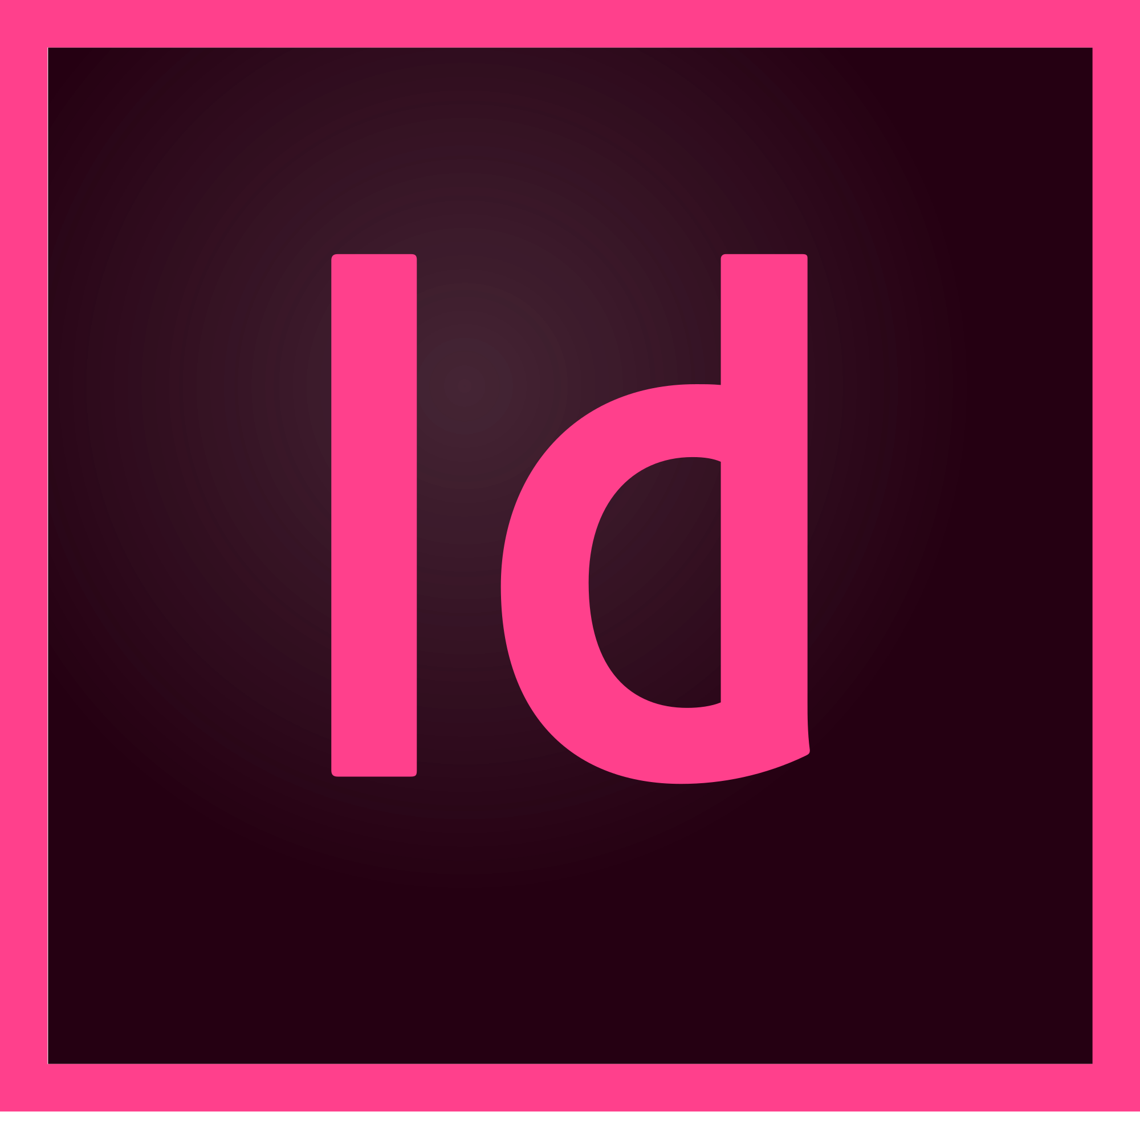
Adobe InDesign
Pros”
You can build accessible EPUB (2.x and 3.x) with this tool
Lots of options for laying out the document exactly as you like
If you are familiar with this tool for creating accessible PDF you will have most of the knowledge you need to make EPUBS
If If you need to export PDF already, creating the EPUB will require very little additional effort
Cons:
Learning Curve is steep for INDesign in general
Creating accessible Docs even more so.
Can be expensive for individual creators. Offered through “Creative Cloud” subscription service
Not accessible to blind creators
The Bottom Line
Powerful tool that is going to be overkill for most creators, but if you are already familiar, you can use It to great effect.

Slide 12

VitalSource Studio
Pros:
Can create highly accessible EPUB 3 Content
Makes the addition of interactive and complex features easier than many platforms
Provides guidance on how to increase and ensure accessibility of content
publications are often more than just a digital copy of a print book.
Offers a ready platform for publishing (VitalSource BookShelf)
Cons
Geared toward publishers and larger educational Institutions
Priced Accordingly. Not affordable for most individual creators
Preference for sale to VitalSource Bookshelf
Additional fees incurred for taking book to other platforms
Not currently accessible to blind or keyboard only users.
The Bottom Line
If you have access to this tool, the learning curve is quite low for creating good looking, highly accessible content, but there is a cost for this privilege. .

Slide 13
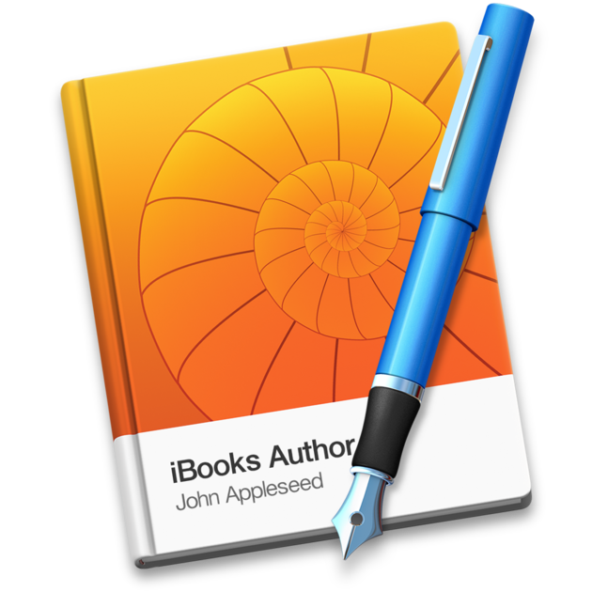
iBooks Author
Cons
Mac only
The EPUB support isn’t quite as “shiny” as iBook’s file type
This blow is significantly softened by the fact that Apple has updated the terms of use for the package and EPUB files can be sold anywhere, including on the iBook’s platform.
The Bottom Line
If you create on the Mac, you can get a fair distance with iBooks Author It should support the tools you need to make EPUBS of moderate complexity with little knowledge of the underlying code.
Pros
At “FREE” the price is certainly right
If you choose the EPUB Templates, you get EPUB 3 Output
WYSIWYG Editor that should be relatively easy to work with.
The Bottom Line
If you have access to this tool, the learning curve is quite low for creating good looking, highly accessible content, but there is a cost for this privilege. .

Slide 14
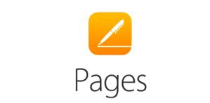
Apple Pages
Pros
Pretty nice EPUB 3 comes straight out of this package when saved as EPUB
Creates a reflowable EPUB with breaks at Heading level 1
Accessible for blind creators
Cons
Mac Only again.
Cleanup may be necessary to get list items and a few other more complex elements to behave properly.
When the output was tested in iBooks on iPhone, there were a few oddities in the way it read. (uncertain if this was the file or iBooks)
The Bottom Line
For Mac users trying to create a EPUB file with minimal complexity, Pages will make the process almost as easy as writing a document and saving it.

Slide 15
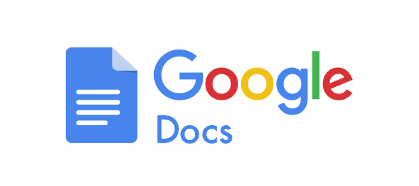
Google Docs “Save as EPUB”
Pros
Once again, almost as simple as writing a document and saving it.
Carries over many (though not all) of the accessibility features included in the original document
Can be used by a blind creator
Cons
If importing a document, you need to be sure that all accessibility features of the original import file make it in. (Our word doc lost alt text on images)
Your mileage may vary- When EPUB check was run this file contained errors.
No way I found to create individual “chapters” all one long document
The Bottom Line
Google Docs will do in a pinch, but further work needs to be put into the “Save as EPUB” option to ensure robust useful EPUB’s can be created.

Slide 16
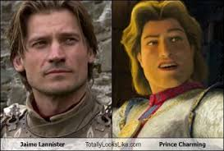
Codex and Calibre
Pros
Can convert Word Docs
Basic conversion is pretty painless
Cons
Output is limited to EPUB 2.x, not the richer 3.x
Tweaking options in Calibre are not accessible
The Bottom Line
It’s simple, but the quality is not going to be all that you might wish. The fact that these options only create EPUB 2 limit you pretty heavily.

Slide 17
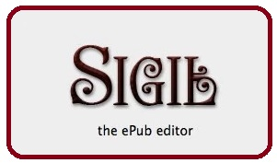
Sigil
Pros:
Free and open source again
Allows the user to dig into the code of a EPUB
Can create and validate EPUB 2 and 3 files
Can be used to tweak existing files if you know the technology
Cons
You are in the weeds of actual code with this one.
As far as I could tell in my initial testing, this package is inaccessible for blind creators on both Mac and PC.
The Bottom Line
All the power and all the pain of coding the book yourself, though it does offer some nice shortcuts in the file menu for common element types. Good for polishing the rough edges off of existing files if you know what you are up to. .

Slide 18
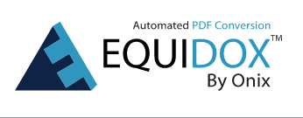
Honorable Mention: Equidox By onix
Not actually a EPUB creation tool, but…
Very simply creates EPUB 2 files
Much more excitingly, it’s great for PDF remediation or conversion to HTML
The HTML conversion of a PDF can be imported into a free tool like Sigil to allow a creator to get a EPUB 3.0 document from an inaccessible PDF
Institutional tool again
The Bottom Line
If you have access to this tool, the learning curve is quite low for creating good looking, highly accessible content, but there is a cost for this privilege. .

Slide 19
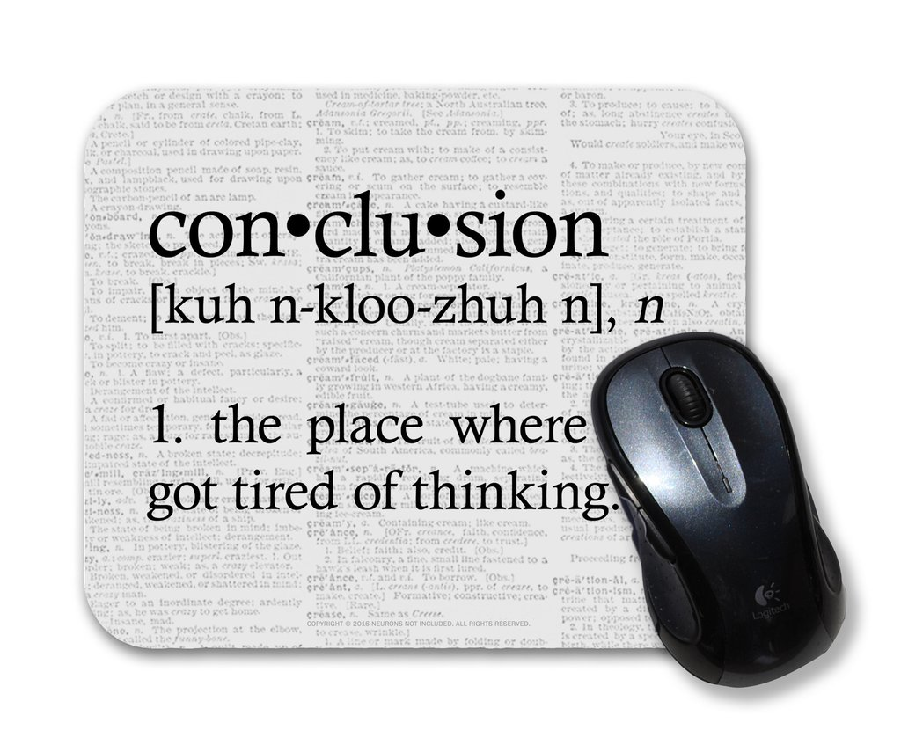
Conclusion
We are making progress in the Accessible EPUB creation space.
Most tools are not quite where we would like to see them, but there are some reasonable options out there for getting a book that is usable, if not technically perfect for accessibility.
We still need a robust tool for conversion from Word to EPUB as many creators still rely on this package.
Even though things aren’t perfect, in many ways the imperfect EPUBS will still outperform PDF especially in the mobile and accessibility spheres, so we should make use of these tools today, and provide all the feedback their creators need to continue improving.

Slide 20
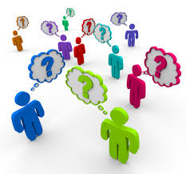
Questions?
Amy Mason, Access Technology Specialist
National Federation of the Blind
AMason@NFB.ORG
(410) 659-9314 (2424)
Offended by the presentation? Blame
Ryan Pugh Rpugh@NFB.ORG

